Slide 1
Supercharge
Your Searches
Name
Title
Date
Notes:
Background: This is a workshop designed to help Splunk users find the turbo button—slim down searches by addressing common mistakes and help users understand how the search engine works under the hood. In many ways, performance is governed by the hardware and Splunk infrastructure already in place, however there are some critical decisions users can make to increase search speeds. Hardware/infrastructure factors are not within the scope of this workshop. The focus of this session are the knobs and levers under the influence of the Splunk end user.

Slide 2
Agenda
Where’s the Turbo Button?
How Search Works
Supercharging Your Searches
Resources
Notes:
“One of the questions we often hear is, ‘Where’s the turbo button?’ We’re working on that, but it’s not easy to make a turbo button that will work for everyone so we want to empower you to make better decisions about how you search. In this workshop, we’ll first describe how users often shoot themselves in the foot without even knowing it. Then we will build your knowledge of the search engine from the ground up by peaking into the Splunk datastore structure. Splunk is not a relational, columnar database. We’ll then apply this understanding to the performance profiles of different types of search and discuss general strategies for each. We’ll also cover ways to customize SplunkWeb for faster searches. Finally, we’ll discuss ways for getting help or going deeper with search.”

Slide 3
Common Search Behavior
^ maybe not so great
> *
Use All Time all the time
> foo | search bar
Don’t use default fields
Discover Fields
Build reports in the Flash Timeline View
Build reports over long spans of time
Build reports on large datasets
Notes:
“How many users are guilty of one or more of the following? Each of these search tactics are inefficient for different reasons. By the end of this workshop you will understand why.”

Slide 4

How Search Works
Search Query Structure
name=waldo | eval loc=long+lat+alt | geoip loc
retrieve events
filter/transform/operate/map
Notes:
<Animated Slide> “You may not have any control over Splunk’s infrastructure—the type and speed of the servers or storage on the backend. The part you do have control over is how you search. Understanding how search works allows you to construct faster searches and participate in optimizing your search experience. At least you will understand where your limits are so you can talk to your Splunk administrator about any infrastructure needs.”
“Keyword searches are your most basic form of search. Keywords can be used with wildcards and Boolean operators to match events and retrieve a dataset matching the query. This is when Splunk behaves most like a search engine or a database. When we start doing more advanced analysis like computing statistics, evaluating expressions or geolocating events, the search language supports this through the use of the | (“pipe”) character. Many of you may already be familiar with the pipe from using Unix command line tools or your recreational activities. ;) For those of you who are not, the pipe character is simply a way of introducing actions on the result set. It is used to pass a set of events to a command which then filters, transforms, operates on or maps the set of incoming events to a new or enhanced event set. Operations or commands can be chained by piping to additional commands.”
“When you have a search which pipes to one or more commands what happens when the search is executed? <click> Everything before the first pipe in the search is evaluated and matching events are retrieved from disk. From there, the events are processed in memory. This means, the more restrictive and specific you can be in the first step (retrieving events from disk) the faster the search. More often, disk is the bottleneck, not memory.”
“Understanding how Splunk works with disk will help you make better decisions about constructing searches. So let’s go one layer deeper…”

Slide 5
How Search Works
db_lt_et_3
db_lt_et_1
db_lt_et_2
db_lt_et_4
db_1290057665_1289504696_1
history
_internal
.tsidx
.gz
main
.gz
.gz
.gz
.gz
.gz
.gz
.gz
Sources.data
SourceTypes.data
Hosts.data
Notes:
<Animated Slide> “Each Splunk instance, can have one or more indexes/indices. An index is simply a folder/directory where a data set resides once it has been indexed and processed. Out of the box, Splunk creates several internal indexes where details like metrics on data throughput, file pointers and search history are stored. As a user, you are mostly concerned with the main index or a set of default indexes your Spunk Administrator has set up for you. The main index is the default destination for any non-internal data collected by Splunk. Understanding the structure of an index is important to understanding how search works.”
<click> “As Splunk indexes data, it writes the data to self-contained subdirectories referred to as buckets or databases. When we say database we don’t mean an RDBMS. A bucket/database is a directory with the naming convention: db_<time of the latest event in the bucket>_<time of the earliest event in the bucket>_<unique sequence ID>. If your Splunk deployment is receiving data in real-time, these buckets will effectively contain mutually exclusive datasets with little or no overlap in time.”
<click> “Each bucket contains 3 important elements: Splunk lexicon files, metadata files, and the compressed raw data.
- *.tsidx – The lexicon files contain references to the location of the raw events. The lexicon acts as a dictionary of all the terms in your data—words, error codes, user IDs, response times, etc
- rawdata/*.gz – The raw events are stored in compressed gzipped files. They are not a replica of original log files.
- *.data -- The metadata files are a listing of the sources, sourcetypes, and hosts represented in the bucket.”
“When a search is executed, Splunk first reads the time range of the search. For that time range, Splunk identifies all buckets which fall into the time range by using the bucket name. Splunk then identifies the terms in the search string. For each bucket in the search pool, the term is ‘looked up’ by introspecting the lexicon files. Then the event is pulled off disk by opening the referenced gzip file and retrieving the event. If the search contains source, sourcetype or host fields, the metadata files are also consulted.”

Slide 6
Types of Searches
Dense
  Use Case: computing stats, reporting
  Example: sourcetype=access_combined | timechart count
Sparse
  Use Case: troubleshooting, error analysis
  Example: sourcetype=access_combined status=404 | timechart count
Rare Term ( or Needle in a Haystack)
  Use Case: user behavior tracking
  Example: sourcetype=access_combined sessionID=1234
Notes:
“How does all this relate to search? Let’s think of search in 3 categories: dense, sparse and needle in a haystack. Each type of search exercises buckets in a different way, which means they each have I/O characteristics which can be optimized differently.”
Notes: Speak to the slide and cover each type. You may want to customize this slide and the next 3 with your own use case example to make it more relevant to your audience. Here, we are using Apache access data and use cases, but this may not be a familiar dataset to your users.

Slide 7
Dense Searches
> sourcetype=access_combined | timechart count
I/O-bound
  Dominant cost is retrieving events from disk
Divide and conquer
  Distribute search to an indexing cluster
  Parallel compute and merge results
Summarize and conquer
  Summary indexing to collect metrics on a scheduled basis
  Report on summarized data vs. raw data
  Transparent summary indexing in next version of Splunk
Notes:
“Summary indexing is an entire workshop on its own so we’ll only touch on them in this session. If you think you have a case to use summary indexing, I’m sure your Splunk Admin will be happy to work with you.”

Slide 8
Sparse Searches
> sourcetype=access_combined status=404 | timechart count
CPU-bound
  Dominant cost is uncompressing *.gz raw data files
  Sometimes need to read far into a file to retrieve a few events
Avoid cherry picking
  Be selective about exclusions (avoid “NOT foo” or “field!=value”)
  In extreme cases, consider indexed fields
Filter using whole terms
  Instead of > sourcetype=access_combined clientip=192.168.11.2
  Use > sourcetype=access_combined clientip=TERM(192.168.11.2)
Notes:
“Most often, searches are for “keyword” or “field=value”. Occasionally they are for “NOT phrase” or “field!=value”. Even more often, these negations just cherry pick a few events off, and it doesn’t really matter. Avoiding their use can make a big difference. In the most extreme cases, if you want to optimize specifically for sparse searches, talk to your Splunk Admin about configuring indexed fields. They do incur a storage cost, so this tradeoff should be weighed against the performance benefit.”
“Indexed fields help when:
1. field=value, value is ubiquitous, field=value is not. (e.g., code=1, code=2, code=3).
2. field!=value, but field=value is ubiquitous. (e.g., status!=200).”
“Even when a search does not seem like a sparse search it can fake like it’s a sparse search. For example, when looking for an IP address, Splunk will actually segment the address into individual octets. It then looks for events containing all octets, in this example “192 AND168 AND 11 AND 2”. Instead, searching for the address in its entirety by using the TERM function will prevent Splunk from doing extra work.”

Slide 9
Sparse Searches
> sourcetype=access_combined status=404 | timechart count
Upgrade to Splunk 4.2
  5x faster in the latest version of Splunk
  Raw data size reduced from 5 MB to 64 KB
Notes:
“In general, using the latest version of Splunk is recommended. In the case of sparse searches, it makes a significant difference. In Splunk 4.2, the raw data format was changed to optimize for this type of search. Instead of writing raw data to 5 MB files, it is now written to much smaller 64 KB files, which means when searching for sparse events, Splunk can be more targeted and less wasteful in what it has to search and throw away in order to find a few events.”

Slide 10
Rare Term Searches
> sourcetype=access_combined sessionID=1234
I/O-bound
  Dominant cost is asking all .tsidx files if a term exists
Bloom Filters
  Coming in the next release
  Bloom filters stored in each bucket
  I/Os to exclude a bucket go from 100-200 to just 2
  50-100x faster on conventional storage, >1000x faster on SSD
Notes:
“Splunk is very good at Needle in a Haystack searches, but it is getting even better. Searches for non-existing terms are a degenerate case of rare term searches. Instead of being bottlenecked by CPU, these types of searches are 100% I/O. What happens in a rare term search is:
For each bucket:
For each .tsidx file:
find term
fail
continue
“It turns out, ruling out buckets can be done much faster with Bloom filters and SSDs.”

Slide 11
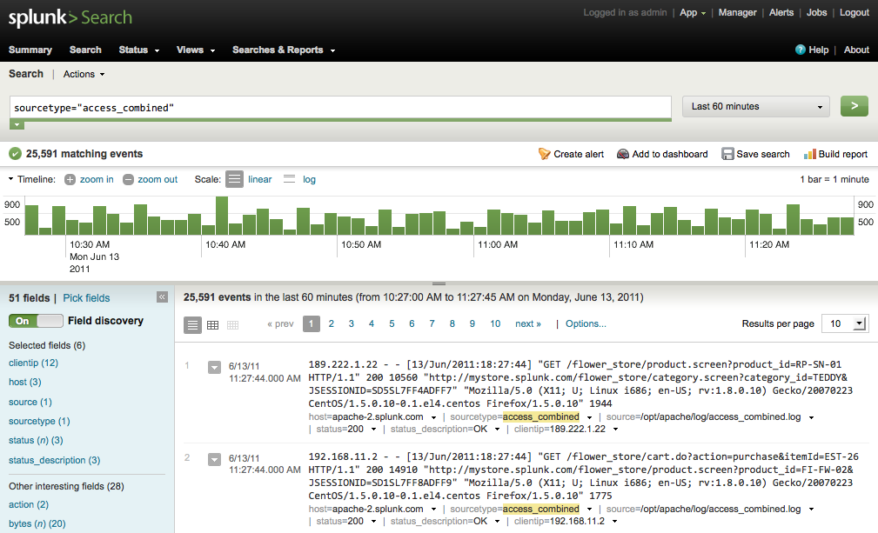
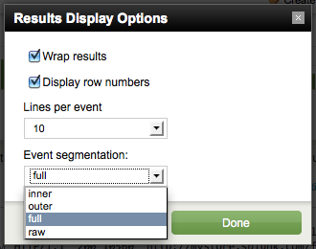
Supercharge the UI
| fields
Use Advanced Charting View
Collapse Timeline
Change Segmentation
Disable Fields
Notes:
<Animated Slide> “In addition to making better decisions about how you search, making better decisions about how you use the UI can make a difference in performance.”
“This is the Flash Timeline View which should look familiar to anyone using Splunk. The timeline, fields and event viewer all contribute to a rich search experience. Yet it may not be necessary to have all these features enabled all the time. Did you know some of these features can be disabled when you don’t need them?
- <click> Timeline: Collapse the timeline if you don’t need a chronological display of event counts. To speed up the timeline, disable Field Discovery
- <click> Field Discovery: Field extractions can become expensive when you have data with hundreds of key=value pairs (e.g. web access data) or extractions which require the evaluation of complex regular expressions. Disabling field extraction or field discovery can speed up searches when you don’t need fields.
- <click> Interactive Events: You can reduce the amount of segmentation Splunk performs on the raw event view. This will reduce the HTML payload, but will affect the options you have to interact with events. While this can provide you with a lot of flexibility to ‘click-and-search’ it does result in more HTML content being delivered as part of the result set. If you don’t need all this flexibility, the other segmentation options are more efficient. For example, let’s take an IP address like 192.168.1.72. With full segmentation enabled Splunk will partition each octet into a term, then 192.168, then 192.168.1, then finally the full IP address. All these terms become hyperlinks. With inner segmentation, only the individual octets become clickable, whereas with outer, only the entire IP address is clickable. Finally, use raw segmentation if you don’t plan to navigate events at all using hyperlinks.
- <click> Advanced Charting View: The Flash Timeline View is built and optimized for fast navigation, to provide quick situational awareness when troubleshooting. When building reports, the Advanced Charting View is much more efficient since it only needs to render the graph and table.

Slide 12
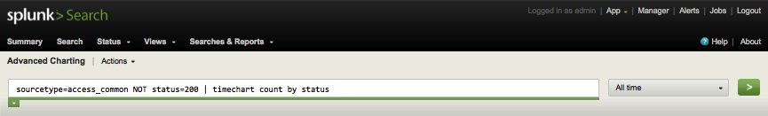
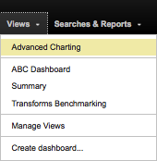
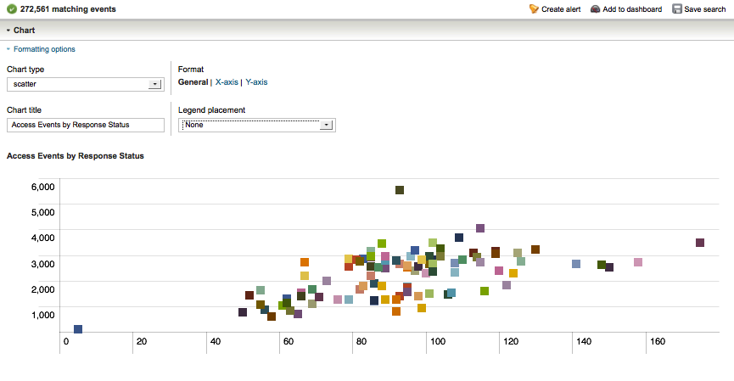
Advanced Charting View
No interactive events
No field discovery
Notes:
“How many people use the Advanced Charting View currently? What is your experience? It may not be as flexible as the Flash Timeline View, but since it does not present clickable raw events and does not do field discovery, it is much snappier.”

Slide 13
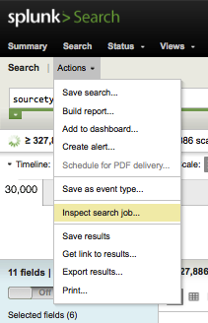
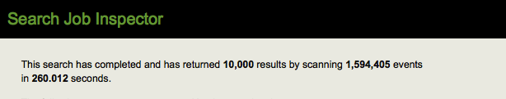
Measuring Search
Using the Splunk Search Inspector
Remote timeline
Timings from
the search command
Timings from
distributed peers
Notes:
“You’re probably wondering if there’s an empirical way to measure the cost of all these moving parts in your own environment. Afterall, systems have their own unique behavior on differing hardware, data sets and usage patterns. To retrieve metrics on each search invocation, use the Search Job Inspector available in the Actions menu. It tracks where Splunk is spending its cycles.”

Slide 14
Reading the Splunk Search Inspector
Metric | Description
index | look in tsidx files for where to read in rawdata
rawdata | read actual events from rawdata files
kv | apply fields to the events
filter | filter out events that don’t match (e.g., fields, phrases)
fieldalias | rename fields according to props.conf
lookups | create new fields based on existing field values
typer | assign eventtypes to events
tags | assign tags to events
Notes:
“The Search Inspector provides a granular breakdown of the time spent talking to the lexicon to retrieving events to the time spent applying knowledge like lookups, eventtypes and tags. If you don’t know what these are, maybe we can cover them in another workshop. In any case, use the Search Inspector to dissect the behavior of your own searches to get a better idea of how to optimize them.”

Slide 15
Test Results
Dataset: Apache access log
Size: 500 MB
Events: 1.5 million
Laptop: 2.4 GHz processor
4 GB RAM
Timeline | x
Field Discovery | x | x
1 Field |  |  |  | x
2 Fields |  |  |  |  | x
Full Segmentation | x | x | x | x | x
Raw Segmentation |  |  |  |  |  | x
Average Run Time in Seconds | 234 | 218 | 62 | 77 | 87 | 62
Notes:
<Animated Slide> “In an informal test of 500 MB of Apache access data, this was the outcome on a laptop with 2.4 GHz processor and 4 GB RAM. The biggest performance boost came from disabling Field Discovery. The same search completed 300 times faster. Disabling the timeline only had a small effect. Also, changing the segmentation made no difference likely because in my setup the search request was local, it did not have to travel over the network. These results will vary depending on your infrastructure and data set. Use the Search Inspector to compile your own results and see what makes the biggest difference for you.”

Slide 16
Supercharge Your Searches
Before | After
> *
Use All Time all the time
> foo | search bar
Don’t use default fields
Discover fields
Build reports in the Flash Timeline
Build reports over long spans of time
Build reports on large datasets
> be=selective AND be=specific | …
Narrow time range
> foo bar
> host=web sourcetype=access*
Disable field discovery or … | fields
Use Advanced Charting View
Use Summary Indexing
Use Summary Indexing
Notes:
<Animated Slide> “Are you learning some useful tips and tricks? I hope so! Let’s apply what you’ve learned in this workshop. Remember these common search behaviors? Let’s start at the top and call out alternatives.” See if the audience can come up with the alternative before clicking to reveal it.

Slide 17
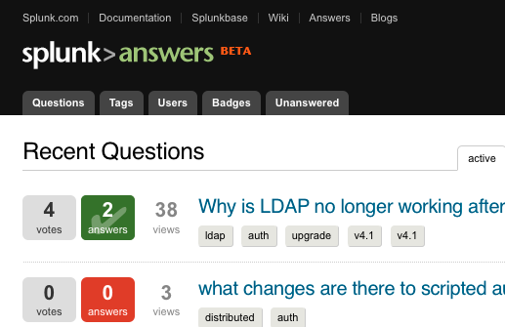
Technical Help: Splunk Answers
http://answers.splunk.com
Community driven
Splunk supported
Knowledge exchange
Q & A
Notes:
“Splunk Answers (http://answers.splunk.com) is a web community which can be very helpful when you have a question. It’s a growing community of Splunk users (like you) and Splunk employees--engineers, support and the field teams. They are users who have experienced similar questions and solved similar problems. They also manage many of the same technologies you have here. Often questions are answered the same day, sometimes even in the same hour.”

Slide 18


Splunk Education
Splunk Education
  Search & Reporting Course
  Pre-Requisite: Using Splunk Course
Splunk User Conference
  August 15-17 in San Francisco, CA
  5 tracks, more than 40 sessions, the smartest Splunk users together
  Sessions dedicated to search (Beginner, Intermediate, Advanced)
Notes:
“In addition to the community Answers site, Splunk offers more formal education—a class specifically about Search & Reporting. What we showed you today was just an overview of what you can expect in class. An instructor will provide a more in-depth review of the search engine and advanced search commands to make you an expert on search.”
“Splunk is also hosting the annual User Conference in San Francisco this summer. There are over 40 sessions with some specific to search. Please let us or your manager know if you are interested in attending or want more details.”

Slide 19
Q&A
Questions?
Examples
Looking Ahead
Notes:
Ask the audience if the workshop was useful, and get ideas for future workshops. Even better, recruit someone in the audience to host a future workshop. If you’re really brave, have a volunteer present a sample search and work interactively to optimize the search:
- time the search
- break the search into its components and see if you can apply any of the optimizations discussed in the workshop
- if they audience was paying attention, they’ll even help
- time the search again to see if there’s improvement

Slide 20
Thank You :)

Slide 21

Graphic for Spreading the Word
Supercharge Your Searches
One of the questions we often hear is, ‘Where’s the turbo button?’ We’re working on that, but it’s not easy to make a turbo button that will work for everyone so we want to empower you to make better decisions about how you search. This is a workshop designed to help Splunk users supercharge their searches—slim down searches by addressing common mistakes and help users understand how the search engine works under the hood. In many ways, performance is governed by the hardware and Splunk infrastructure already in place, however there are some critical decisions users can make to increase search speeds. Get smarter. Go faster.

